Slide 1
Welcome to the Interim Assessment Training
Office of Assessment

Slide 2
West Virginia Interim Assessments for Teachers
Dr. Stacey Murrell

Slide 3
Agenda
Interim Assessments
Interim Comprehensive Assessments (ICAs)
Interim Assessment Blocks (IABs)
What interims are NOT
Purpose of interim assessments
Hand scoring
Reports
Enhancements 2015-2016
WV Diagnostics
What diagnostics are NOT
Purpose of diagnostic assessments
Reports
Next Steps

Slide 4
Interims are NOT
The tests are NOT required or mandated by WVDE.
The interims are NOT benchmarks.
There is NOT a WVDE-set or mandated schedule for administering interims.
There is NOT a WVDE-mandated plan for aligning curriculum to interims.

Slide 5
Purpose
The purpose of the WV Interim Assessments is to support teaching and learning throughout the year.
Experience a clone of the summative test
Focus on targets/skills, fewer questions
Receive reports that provide feedback on assessment claims and targets
Available for ELA and math, grades 3-11

Slide 6
Question Development
Developed using the same conditions, protocols, and review procedures as the West Virginia General Summative Assessment items.
This means the Interim items assess the WV NxG standards, were designed using principles of Universal Design, and provide evidence to support ELA/literacy and math claims.

Slide 7
Non-public Tests Not Secure
The interim assessments are not released to the public.
WVDE purchased interim tests.
The tests are not secure, but they should be kept offline (consider social media).

Slide 8
Types of Interims
There are two types of interim assessments.
The Interim Comprehensive Assessments (ICAs) use the same test blueprints as the WV General Summative Assessment and assess the same standards.
The Interim Assessment Blocks (IABs) focus on smaller sets of targets and are more flexible to better support instruction.

Slide 9
Interim Comprehensive Assessments (ICAs)
Have the same testing blueprint as the general summative assessment and mirrors the summative testing experience
Have the same item types and formats, including performance tasks
Give students an overall scale score, an overall performance level designation, and claim-level information- same as summative student report
Claim Performance Results are reported as “Below Standard,” At/Near Standard,” and “Above Standard.”

Slide 10
Interim Assessment Blocks (IABs)
Smaller assessments that focus on sets of targets and can be used to support instruction (approx. 13-18 questions).
Contain the same item types and formats, including performance tasks, as the general summative assessments.
Students receive an overall score for the IAB. The results for the IABs are reported as “Below Standard,” “At/Near Standard,” and “Above Standard.”

Slide 11
Administration
Both interim assessment types are assigned by teachers and taken by students online.
They will use the same delivery software as the general summative assessments.
Teachers use the WV Assessment Portal.
Students use the WV Student Secure Browser. Note: There is a new version of the secure browser that must be installed on every student computer. This may require help from your county or school technology coordinator. The new browser download can be found on the WV Assessment Portal.
Because interims and diagnostics are not secure, teachers can schedule the interims and diagnostics around their schedules. For example, you could schedule your computer lab for Monday, Wednesday, and next Monday for testing. Your students would work for the 45-50 minutes you have them in the lab that day and then when you return the next scheduled day, their answers will pick up where they saved the test from the last computer lab day. Teachers just need to give a new test session number each time they are back in the computer labs. Students can take as much time as need to complete interims and diagnostics.

Slide 12
Scoring
Automatic Scoring
Items that are able to be automatically scored will be scored by the computer.
Teacher Hand Scoring
Constructed response items and performance task ELA essay/ math performance task response items are not able to be automatically scored; therefore, these items will be scored by teachers using a scoring rubric.
Teachers will need to complete their hand scoring of the constructed response items and performance task ELA essay/math extended response items before any reports can be generated for both the ICAs and IABs.
NOTE: The WV General Summative items/essays are hand scored by individuals contracted by the test vendor, not the teachers of the students.

Slide 13
Interim Reports

Slide 14
Interim Comprehensive Assessments (ICAs)

Slide 15
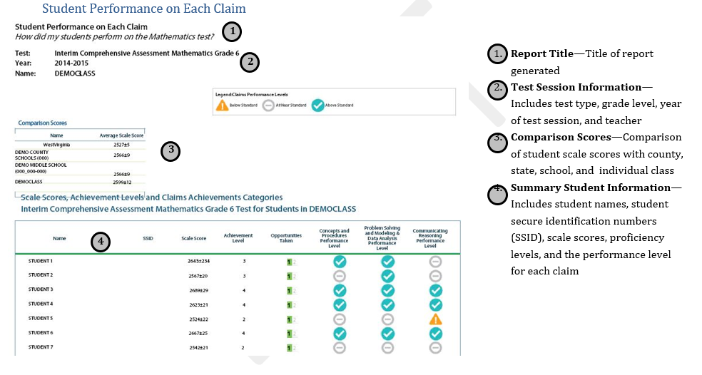
Interim Comprehensive Assessments (ICAs)

Slide 16
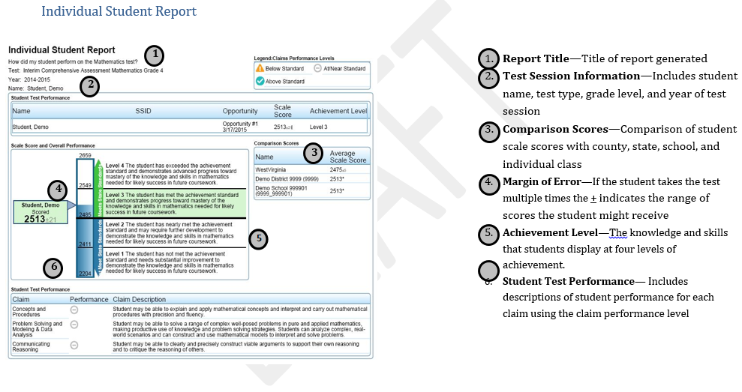
Interim Comprehensive Assessments (ICAs)

Slide 17
Interim Assessment Blocks (IABs)

Slide 18
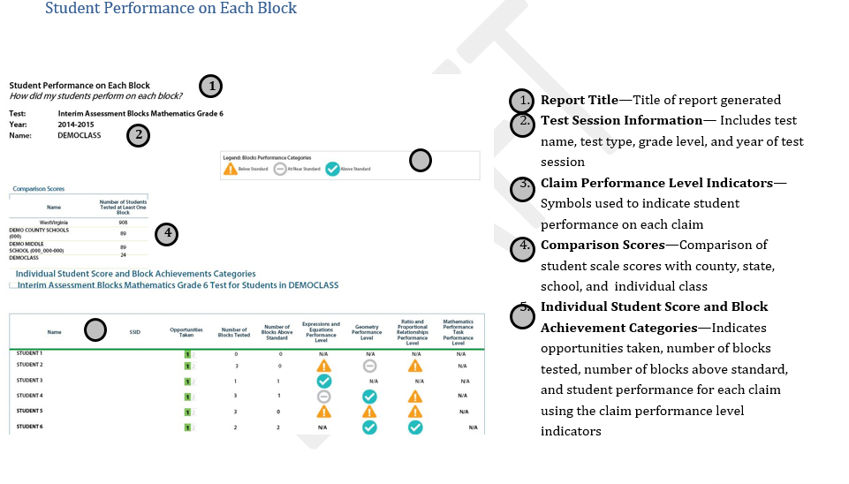
Interim Assessment Blocks (IABs)

Slide 19
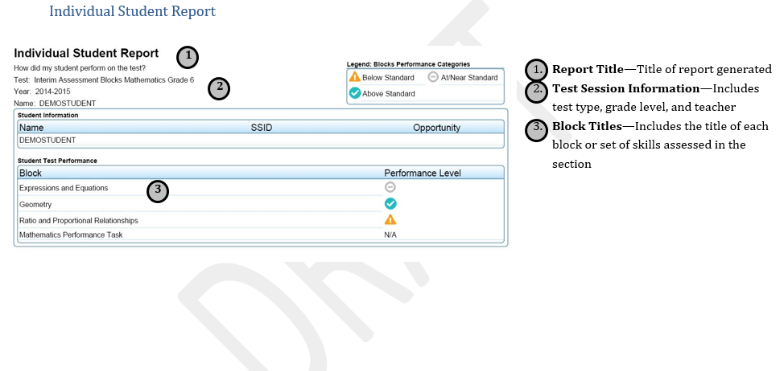
Interim Assessment Blocks (IABs)

Slide 20
Interim Enhancements for 2015-2016
The test names are being changed to be more concise, consistent, and clear.
Students will have unlimited opportunities to practice interim tests.
Selecting an interim test will “look” different than when selecting a summative test. Less confusing.

Slide 21
WV Diagnostic Assessments

Slide 22
Diagnostics are NOT
The tests are NOT required or mandated by WVDE.
They are NOT benchmarks.
There is NOT a WVDE-set or mandated schedule for administering diagnostics.
There is NOT a WVDE-mandated plan for aligning curriculum to diagnostics.

Slide 23
Purpose
The purpose of diagnostic assessments is to provide feedback on students’ performance.
Reports will have the content standard (WV NxG) that each test question is aligned to and how the class/student answered the question.

Slide 24
WV Diagnostics
Available for grades 3-11
ELA Diagnostics
Reading Literary Texts
Reading Informational Texts
Research
Math Diagnostics
Concepts and Procedures
Problem Solving and Modeling & Data Analysis
Communicating Reasoning
Performance Task

Slide 25
Developed
Written by WV teachers using the same item writing specs as the general summative test and interim tests.
There are 600 diagnostic questions, but that is not as robust as interims.
We hope to add more diagnostics as we see that teachers and students find them helpful.

Slide 26
What are the Diagnostics?
Structured like Interim Assessment Blocks (IABs). Approx. 5-20 questions per diagnostic.
ELA Diagnostic Blocks are arranged by Clusters (Reading Literary, Reading Informational, Research)
Math Diagnostic Blocks are arranged by the Claims (Concepts and Procedures, Problem Solving, Communicating Reasoning, and Modeling and Data Analysis)

Slide 27
Why use a Diagnostic? Reason One
Diagnostics will report out a Class/Student Item Analysis Report. Report shows the content standard or target, if no standard possible (Math Claims 2,3, and 4) that each question is aligned to and how students performed on that standard or target.
Interim reports indicate performance on the cluster or domain level (IABs) or the claim level (ICAs). Below, at/near, or above standard.

Slide 28
Why use a Diagnostic? Reason Two
Grades 9 and 10 have their own Diagnostic tests. Written by WV 9th and 10th grade teachers.
Interims are grade 11. Grade 9 and 10 students can use grade 11 interims. By default, grade 9 and 10 students can access grade 11 interims.

Slide 29
Shortcomings of Diagnostics
Not enough tests
Reports are not as robust as the ICAs. You won’t get scale scores, level designation (1, 2, 3, or 4), or claim level designation (below, at/near, or above standard).
Reporting is still being finalized by AIR. October 19 is when diagnostic reports will appear in ORS.

Slide 30
WV Diagnostic Reports

Slide 31
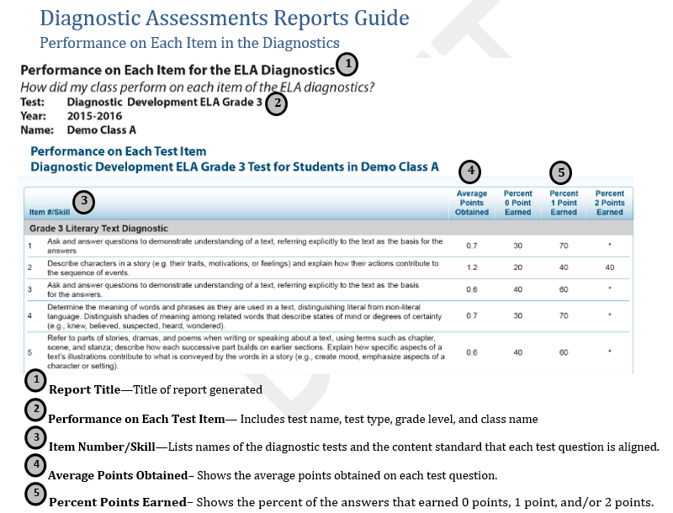
WV Diagnostics

Slide 32
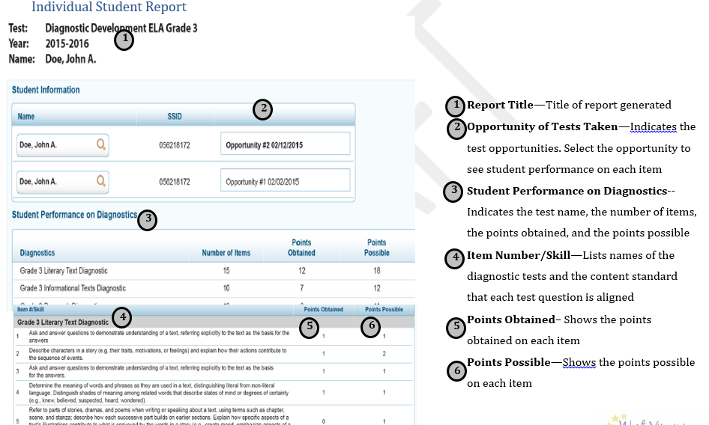
WV Diagnostics

Slide 33
Next Steps: Using Interims and Diagnostics
September 15, 2015 is the “opening” of both.
All embedded designated supports and accommodations for students, such as text-to-speech will be available to students taking interims.
Diagnostics only have embedded text-to-speech (P01).
Remember, teachers will have to hand score any constructed response (ELA and math PTs) and essays (ELA) before reports will appear.
Principals will have to associate teachers to students for the 2015-2016 year by creating/managing rosters for the Online Reporting System. Must wait until your county has sent WVEIS promotional file and TIDE has uploaded the file.

Slide 34
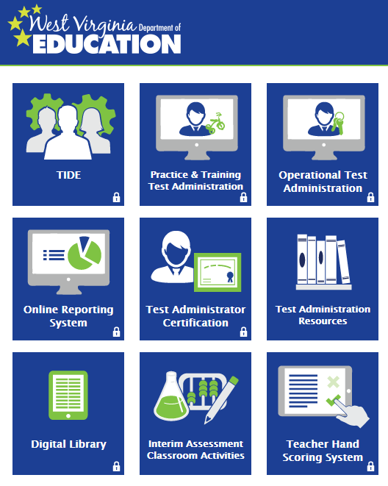
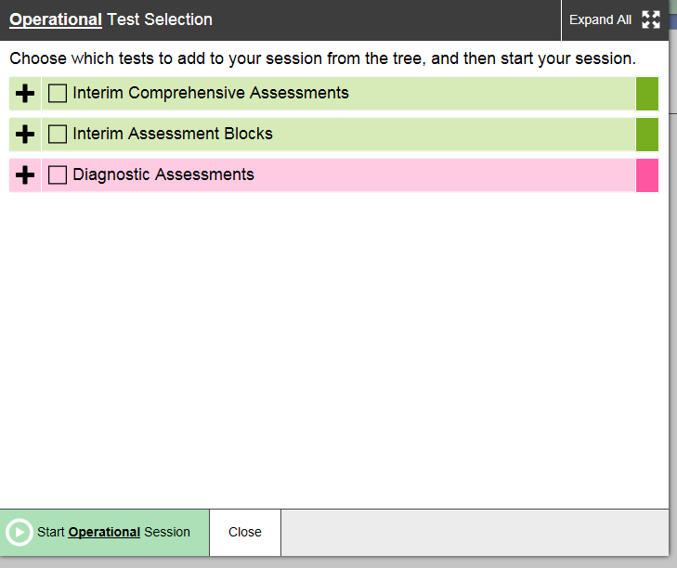
Interim Assessments
Interim Comprehensive Assessments (ICAs)
Interim Assessment Blocks (IABs)
Not the same as Practice Tests.
Access through the WV Portal
Operational Test Administration

Slide 35
Questions
slmurrell@k12.wv.us
Handouts available on Stacey’s OneDrive
http://tinyurl.com/wvnxg-interims

