Slide 2
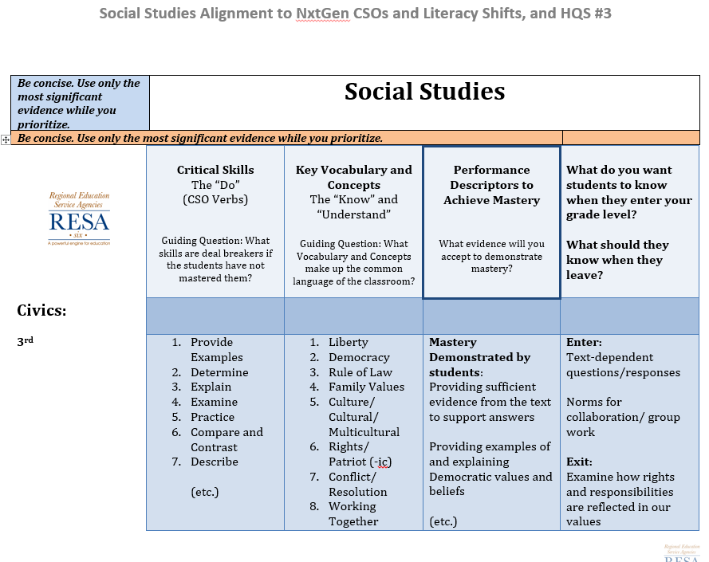
Example CAP Progression Doc: 3rd Grade Civics
1. Teachers review and rank the Next Gen CSO’s for the Action words – the “Verbs”.
2. Teachers review and rank key vocab
and concepts.
3. Teachers extract language from the Performance Descriptors for Mastery and from their own expertise/experience for evidence of justifying mastery level work.
4. Finally, the link between grade levels is established, reviewed, and, if necessary, revised.
Notes:
Sample: Completed annotated CAP Progression document…completing one column at a time

